Slide 1
EAP Manager Orientation
1-800-624-5544
https://eap.ndbh.com

Slide 2
The Details: Cost and Confidentiality
Cost:
The EAP is a benefit offered to you and your dependents by your employer at no cost
Up to 6 face-to-face counseling sessions per life challenge/issue per household member and dependent up to age 26 per year (face to face, telephonic or text)
Eligible users:
You, anyone living in your household and dependents outside of the home up to age 26
100% Confidentiality:
No one will know you have used the program unless you give permission to discuss it or tell them yourself

Slide 3
Common Reasons People Use the EAP
Relationship and family challenges
Stress and worries
Life changing events
Elder care concerns
Legal questions
Workplace challenges
Overwhelming anxiety or feeling blue
Substance dependence or addiction
Conflict resolution
Medical issues or illness
Grief or loss
Childcare
Budgeting w/ a financial professional
Support in the proactive or reactive
stage of life’s challenges
800-624-5544

Slide 4
Common reasons people seek counseling
With the Employee Assistance Program (EAP) you get:
Up to 6 counseling sessions per life topic per year at no cost.
A preferred in-network EAP provider
Counseling for you and your household members and dependents up to age 26 not in your home.
MONEY

Slide 5
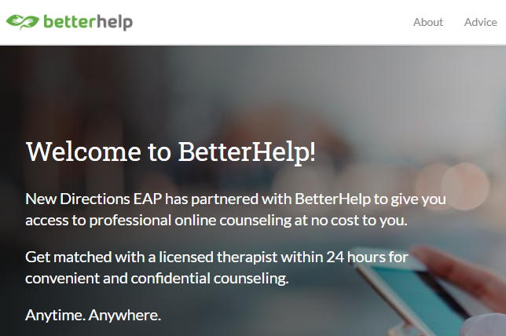
6 free sessions
BetterHelp.com/NewDirections

Slide 6

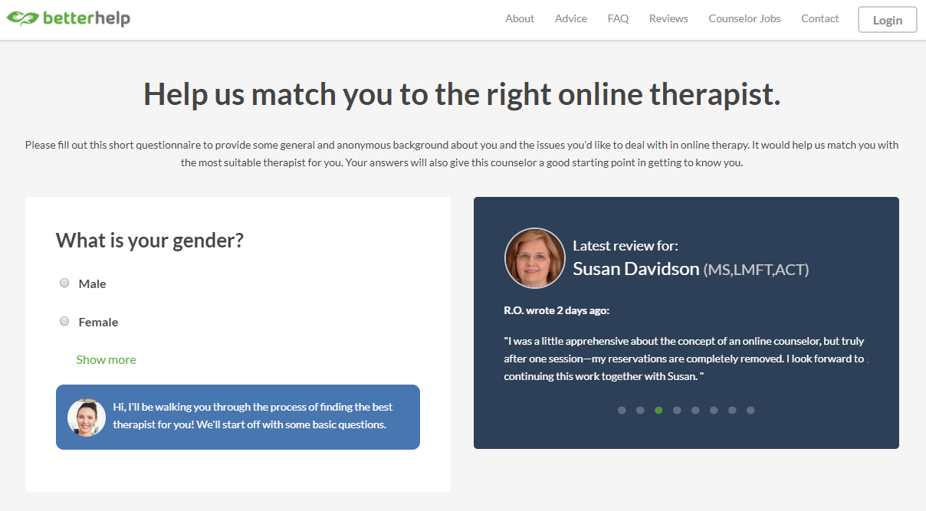
Complete registration and get matched with a therapist Therapist match could take up to 24 hours
Download app and start therapy message, chat, phone, video

Slide 7

EAP is way
more than counseling
Short-term Counseling
Online Therapy
Performance/Life Coaching
Work/Life Resources
Financial and Legal Consultation
Personal and Professional
Development Training
Notes:
Our services include a vast range of tools including ……….

Slide 8

Financial & Legal support
30-minute free telephonic consultation, calculators, documents & more
Credit counseling
Divorce and child support questions
Tax planning
Retirement and college planning
Budget assistance
Estate planning
Collections
Bankruptcy
Contractual disputes

Slide 9

Work/Life
Your personal assistant.
Chat with a specialist or receive local resource referrals for:
Adoption
Elder, Adult & child-care
Education
Health & Wellness
Travel
Home repairs/contractors
Summer camps

Slide 10

Coaching - 6 sessions
Specialized input & advice
Improve and work to improve your:
Health
Wellness
Lifestyle
Work Performance

Slide 11
Don’t overthink it. Just call if you’d like.
CALL (800) 624-5544
Assessment
FIT FOR EAP
SHORT-TERM
COUNSELING
WORK/ LIFE
LEGAL
CONSULTATION
ONLINE
TOOLS
FINANCIAL
CONSULTATION
LIFE COACHING
Notes:
If there are questions about the mental health benefit then that is also reviewed and discussed.

Slide 12

https://eap.ndbh.com
northeastern university

Slide 13
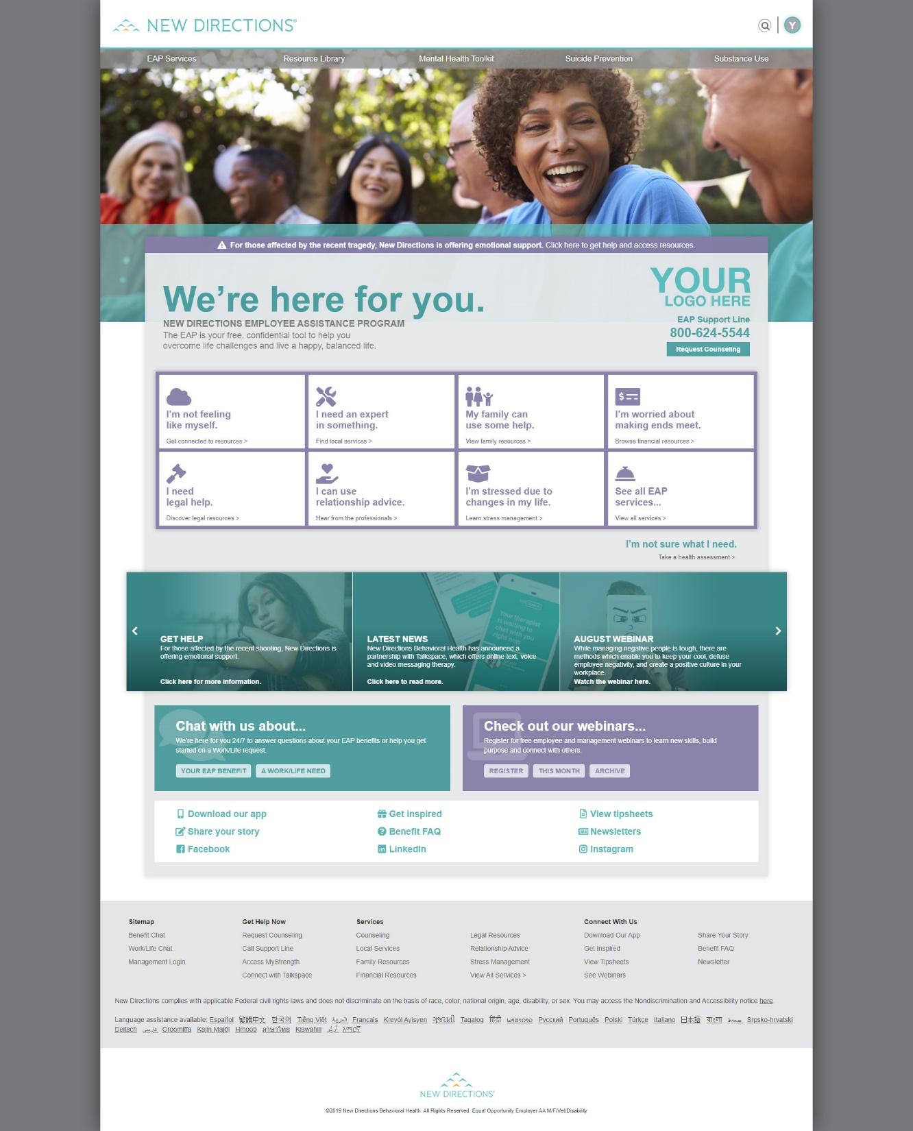



Slide 14
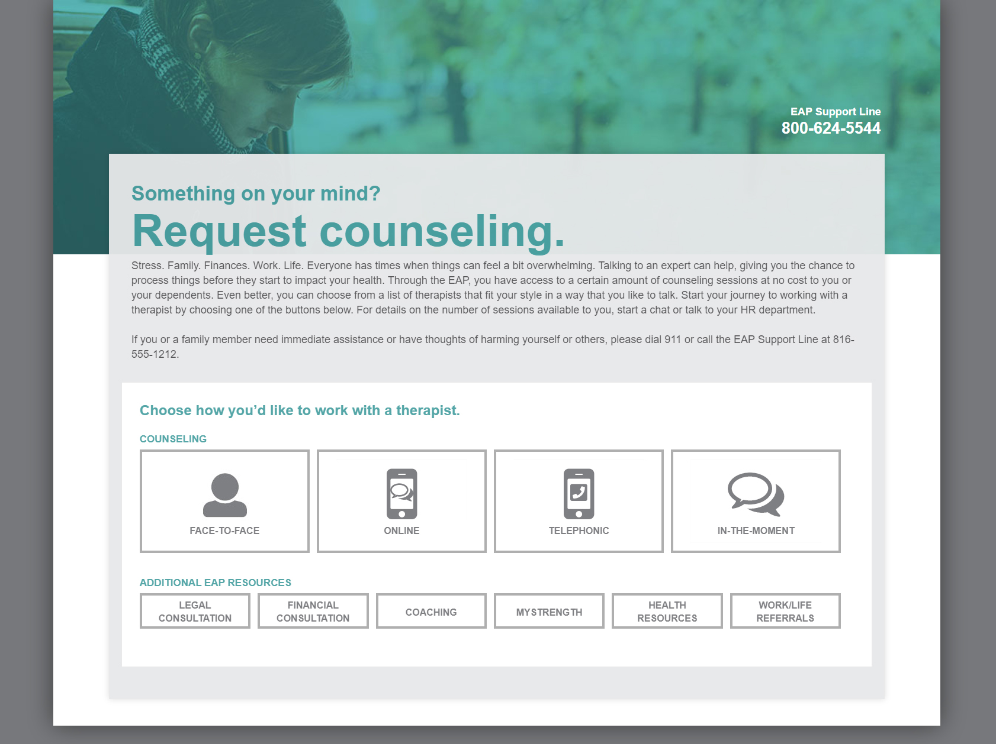

Slide 15
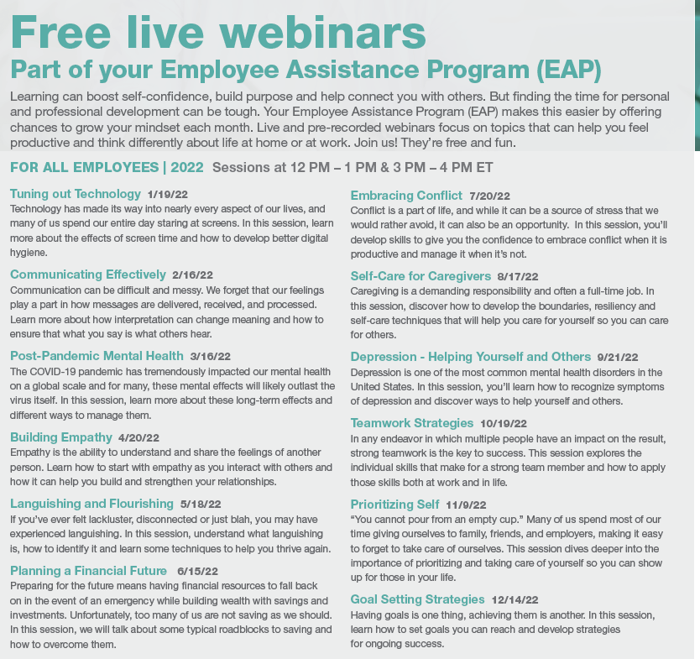
2022 Content calendar for scheduled live monthly webinars

Slide 16
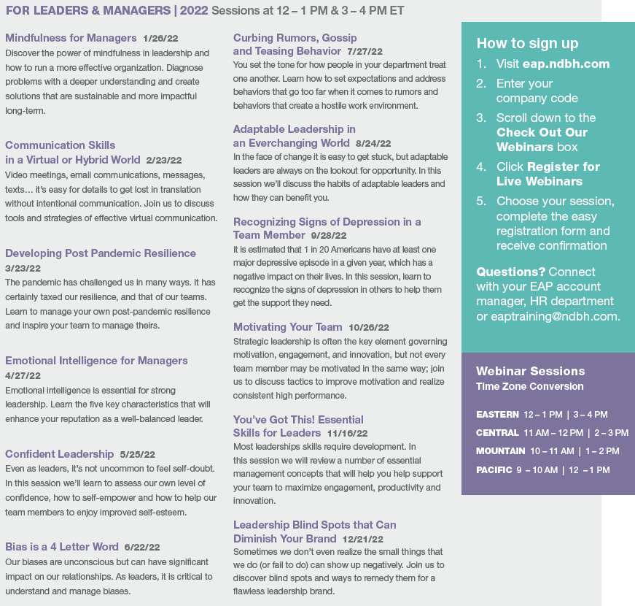
2022 Content calendar for Leadership series

Slide 17
MANAGEMENT
TOOLS

Slide 18
EAP AS A MANAGEMENT TOOL
Recognize and support employees in need
Get your organization and its people through crisis
Best manage employee performance issues
Continuously grow skills to grow your business
Manage people so focus is on work and help retention
Promote, raise awareness and refer to EAP

Slide 19
help identify opportunities to refer to EAP
“I’m feeling sad, overwhelmed, nervous, stressed, no energy, can’t sleep, hopeless, frustrated, angry…”
“My child is being picked on in school. I don’t know what to do”
“My mom died recently, and I don’t know how I am going to handle it”
“My parents can’t take care of themselves anymore, and I’m missing a lot of work”
“My sister has moved in with us, and its not working out. Things are really rough”
“I was in a car wreck and I really want to talk to a lawyer”
“I can’t find a daycare to take care of my child”
“I have been getting calls from collectors at work”

Slide 20

Management consultation and support line 24/7/365 Call 800-624-5544
Work performance issues
Substance use concerns
Threats to workplace or employees
Customer safety issues
Employees in crisis
Assessment for employees returning to work
Coordinated emergency intervention
Management training
“When I’m unsure of how to handle a situation with one of my direct reports I look to EAP for guidance. Big or small issues, they give me advice I can act on quickly and in a smart way.”

Slide 21
management/HR consultation & support
Management Consultation Support line: One phone call, all your needs
Workplace or community crises | Work performance issues Substance Abuse Issues | Threats to workplace or employees Customer safety issues | Employees in crisis | Fitness for Duty
Dedicated support available 24/7 includes:
Guidance and consultation on any need
Site/situation assessment
Formal process and referrals for employee performance issues
Manager training Coordinated emergency intervention
On-site counseling
Employee resources
Notes:
Dedicated team of specialists via the Management Resource Consultation Team (MRC)
Team approach allows for immediate access 24/7/365
Consultation to assess the situation
Plan of action developed by clinician and immediate support is provided
Intervention, including formal referral, information referral, consult only or on-site support
Tip sheets provided
Follow up on every case

Slide 22
How to Access the EAP
Self referral
Employees call for the appointment
Recommendation
Reminded about EAP benefits
Employee is encouraged to call
Supervisor recommendation
Formal processes
Supervisor or HR initiates referral
Paperwork submitted to EAP
Focus on work performance
The call is confidential

Slide 23
Formal Referral Process*
Always start with calling us first at 800-624-5544 – Press #2
NON-MANDATORY
Strongly recommended
New Directions stays involved to completion
MANDATORY
A requirement of continued employment
New Directions works with HR or Supervisor to promote improved work performance
*Always work with Human Resources
Always requires a Release of Information signed by the Employee

Slide 24

Critical Incident Response Support 24/7
Death of an Employee or other significant loss
Shooting the community
Reduction in Force
Workplace violence
Critical illness of an employee
Call New Directions at (800) 624-5544
Press #2 – Speak to a clinician
To provide in the moment support to the manager/supervisor
Be a sounding board
Send tip sheets
Coordinate onsite support clinical support if needed

Slide 25
HOW YOU GET IN TOUCH

Slide 26

partners for better health
Clinicians available 24 hours a day, 7 days a week
Our clinicians average 15+ years of experience
No time limits on calls
Employees can reach out as often as they need to do so

Slide 27
CONNECT WITH THE EAP
CALL 800-624-5544
In-the-moment support, by-appointment counseling, referrals, financial & legal consultation
TEXT VIA BETTERHELP: www.betterhelp.com/newdirections or click on ‘request counseling” “online” on our website to register.
Short-term counseling
LIVE CHAT – for worklife requests only
Access chat at eap.ndbh.com
ONLINE @ eap.ndbh.com (company code: northeastern university)
Request a counseling session, watch webinars, view helpful articles, visit the legal & financial center
EAP APP (company code: northeastern university)
Request a counseling session, watch webinars, view helpful articles, visit the legal & financial center

Slide 28
Get Started Today
Visit https://eap.ndbh.com
Company code: northeastern university
You can:
View thousands of resources on topics
Chat with EAP worklife professionals
Request an EAP session
Set up Online/Text Therapy with BetterHelp
Complete your will for free on-line
Access financial and legal tools
We love it when you CALL
1-800-624-5544

